Slide 1
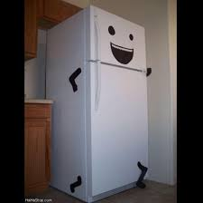
Fault detection of a supermarket refrigeration system
Zoltan Mark Pinter
Supervisors: Hans Henrik Niemann, Dimitrios Papageorgiou
External Supervisor: Lars Finn Sloth Larsen

Slide 2

Refrigeration systems – our source of happiness

Slide 3
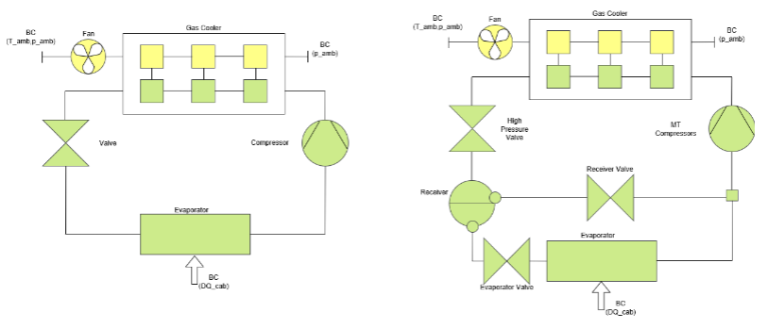
Refrigeration system

Slide 4
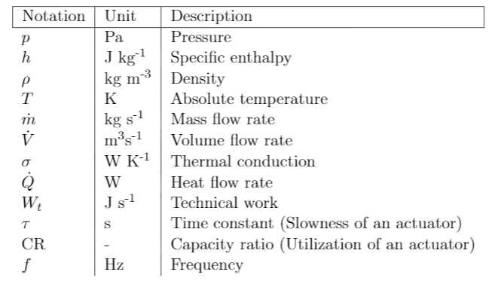
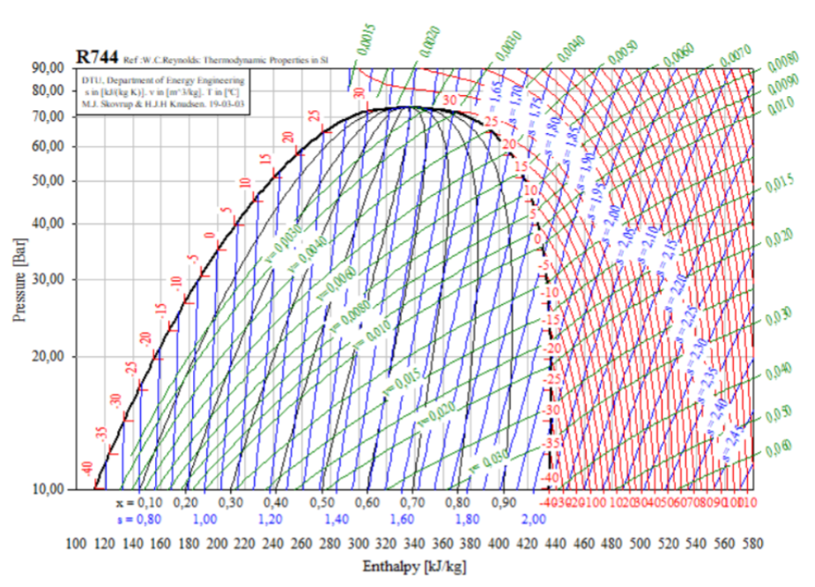
Notations
Cheat sheet
Take enthalpy as energy
If pressure increases, temperature increases
If pressure increases, density increases
If enthalpy increases, density decreases
If enthalpy increases, temperature, or vapour ratio of 2 phases (def.: quality) increases
Above saturation curve: 1 phase, below: 2 phases
Left side of saturation curve: liquid

Slide 5
Refrigeration system, project scope
Range: 10…30 degrees

Slide 6
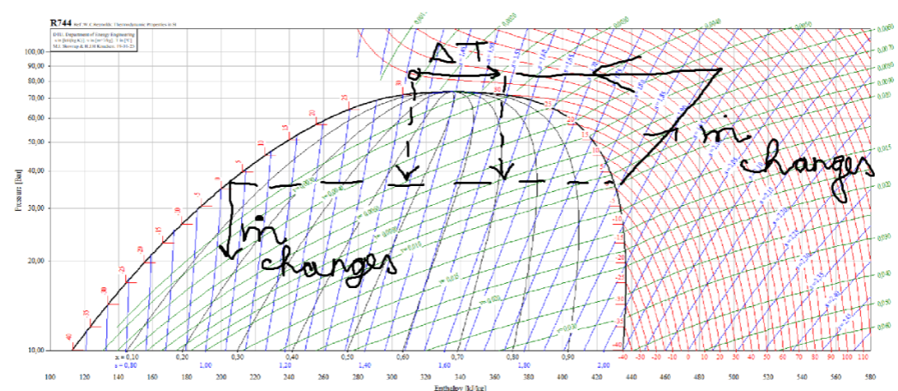
Project Goal: Gas Loop Detection, and fault tolerant control
Temperature measurement has negative offset
Fans stop, enthalpy, then pressure increase, until compressors are saturated
Gas in cycled quickly in system without achieving necessary heat transfer
Efficiency drops and cabinets heat up
Goals:
create residuals for detection, then detect
Create necessary

Slide 7
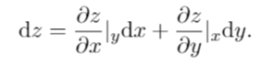
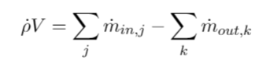
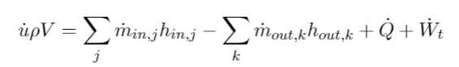
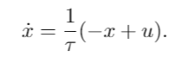
Differential equations
Partial differentials
Mass balance
Energy balance
Low pass filter
Main assumption: equilibrium

Slide 8
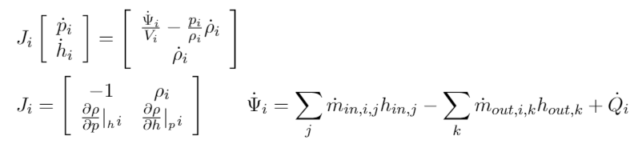
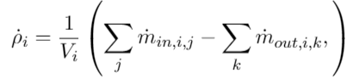
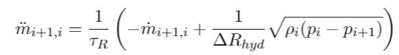
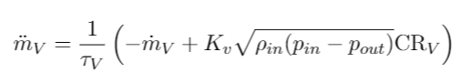
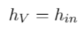
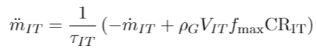
Model Description
Volume equations (for cells): density, enthalpy, pressure changing
Concentrated component equations: mass flow rate changing
Spatial temperature difference distribution
Flow resistance
Valve equation
Compressor equation: current generator
Air temperature state
Disturbance

Slide 9
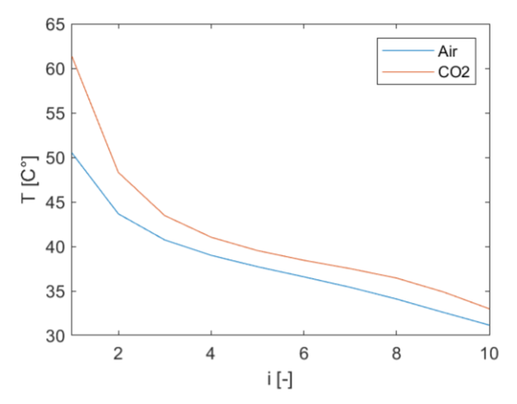
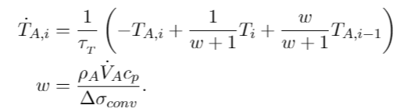
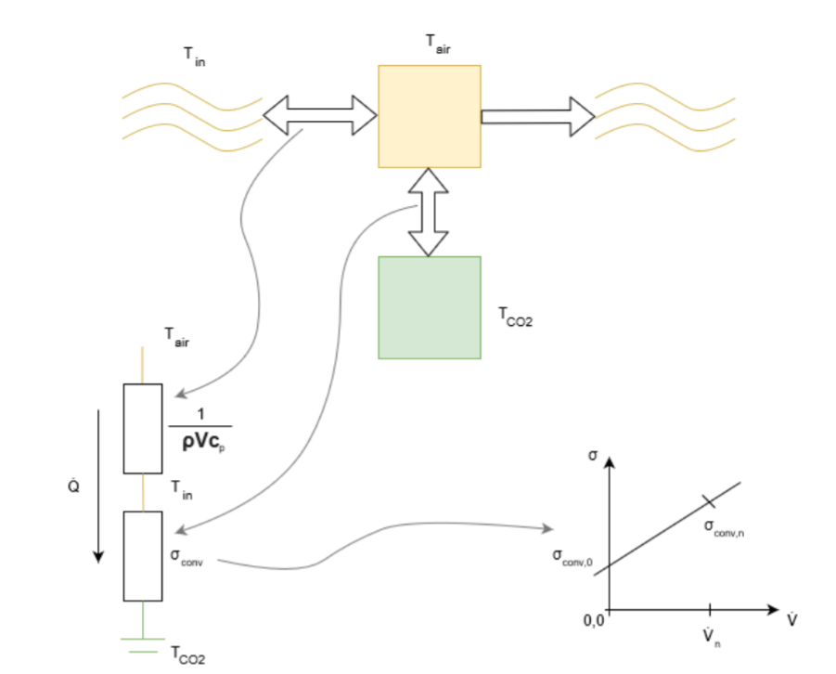
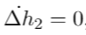
Model Description
Spatial temperature difference distribution
Air temperature state
Disturbance

Slide 10
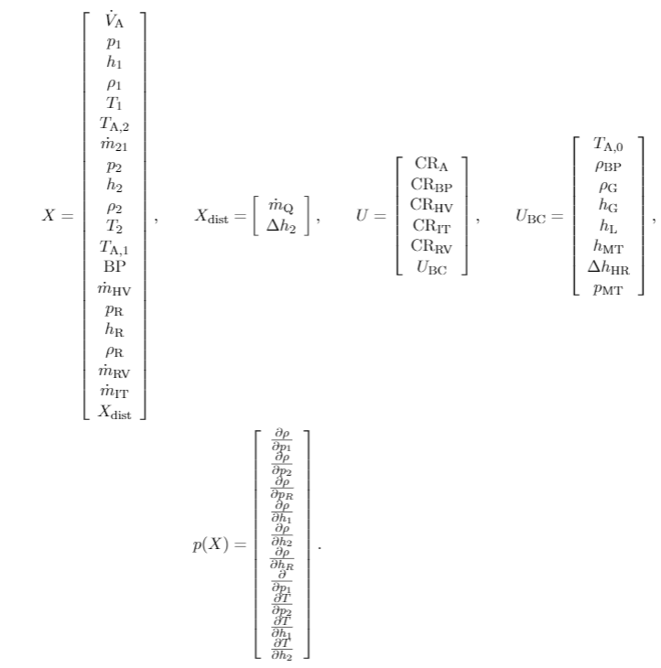
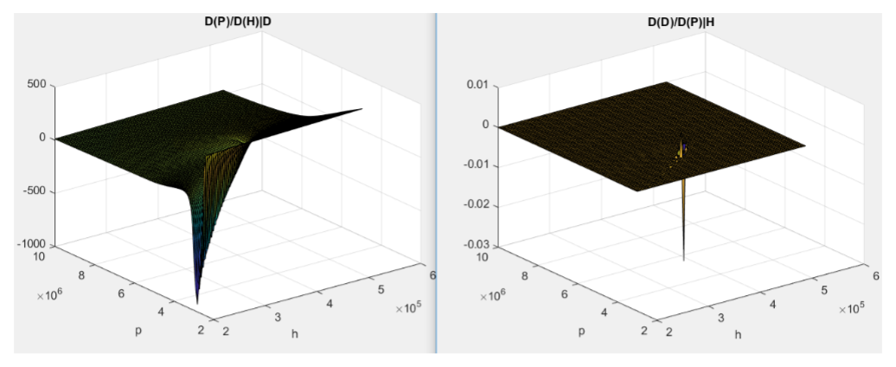
Simlifications
Problems
Negligible details: fast dynamics, pressure change contribution to enthalpy change
Parameter uncertainty: unknown time constants
Controllability issues: derivatives
Observability issues: gas cooler
Too many states for estimator
Partial differentials cover several order of magnitudes

Slide 11
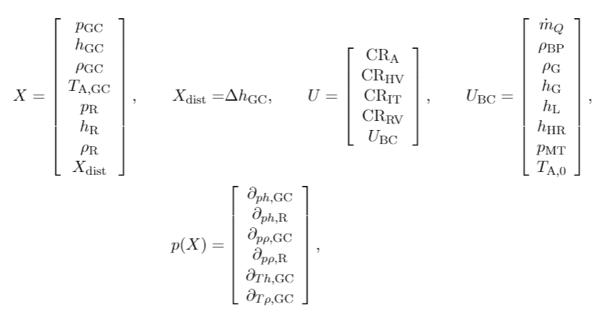
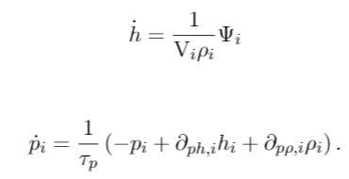
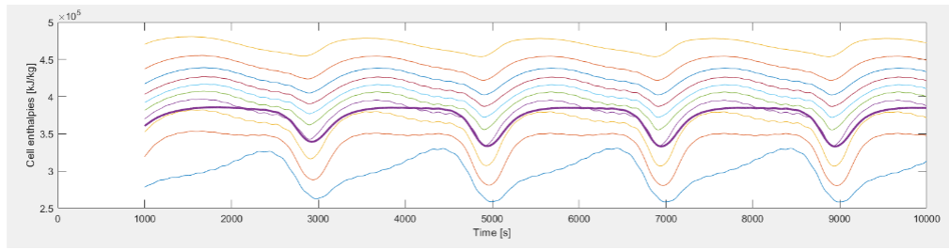
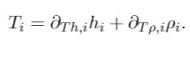
Simlifications
Solutions
Not derivatives, but states were connected
Density and enthalpy are ‘true states’, pressure and temperature are ‘projected states’, connected with fast dynamics
Only one cell in gas cooler
Constraint as measurement
No actuator dynamics

Slide 12
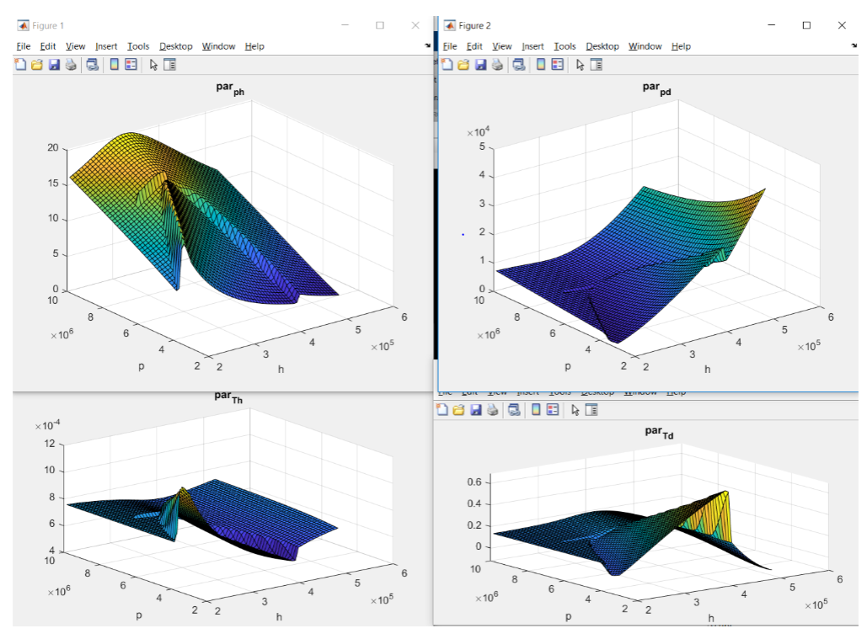
Simlifications

Slide 13
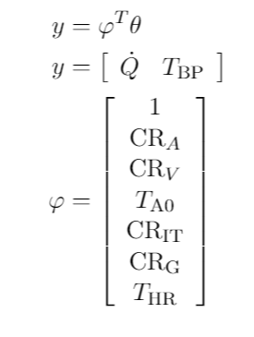
Residual Generation
LTV estimator -> parameters are dependent on states -> high Kalman gain is needed to avoid getting stuck in local minima
Residuals provide very weak detectibility
New strategy: based on only measurements and physical assumptions
Steady state energy balance, small deviations during transients
Large deviations: something ‘special’ entered the system
Fault detection: freezing parameter values until fault disappears

Slide 14
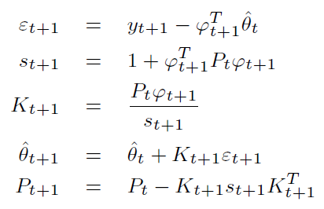
Recursive Least Squares
No dynamics assumed

Slide 15
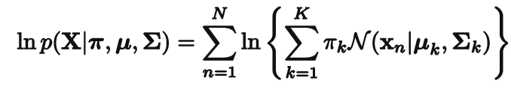
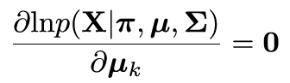
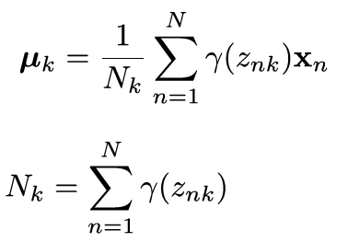
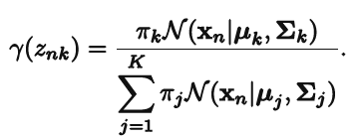
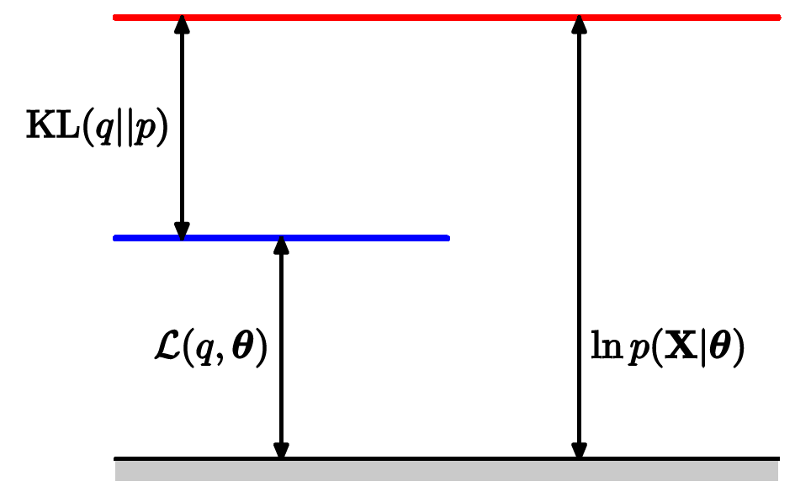
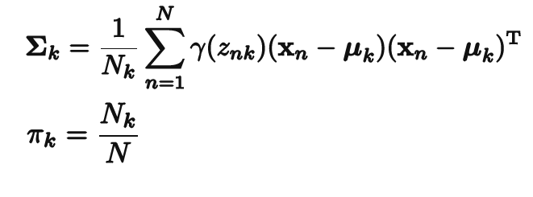
Expectation Maximization Fault Detector
Minimizing log-likelihood of two Gaussian Mixture Model clusters:
Faulty, non faulty
Intuitive idea: a cluster with large variance gives higher density on faulty residual values

Slide 16
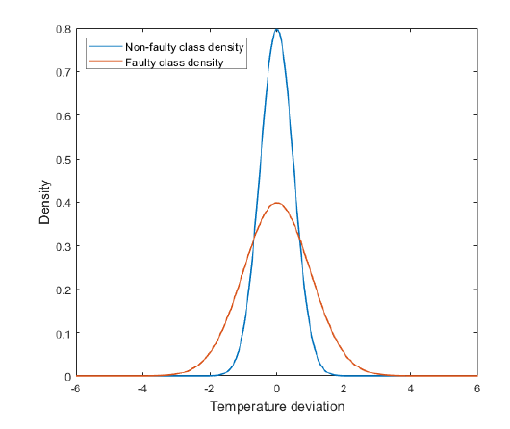
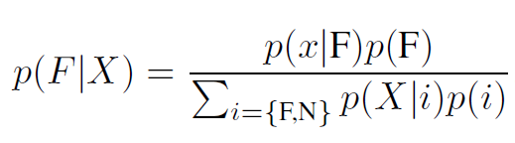
Expectation Maximization Fault Detector
Intuitive idea: a cluster with large variance gives higher density on faulty residual values

Slide 17
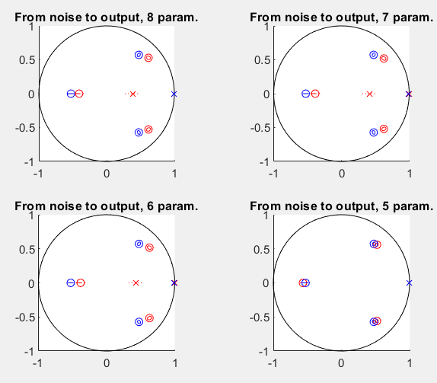
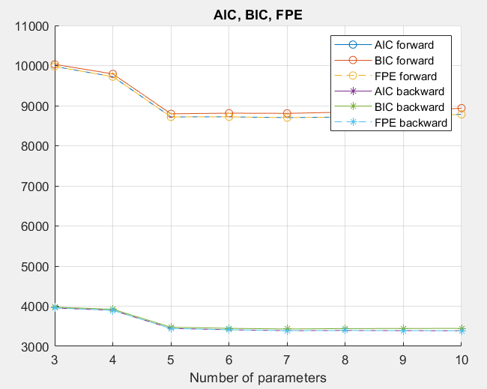
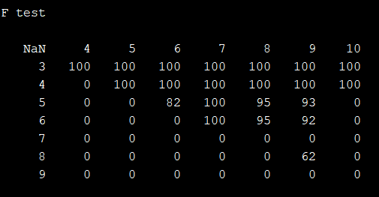
Residual Whitening, structure criteria

Slide 18
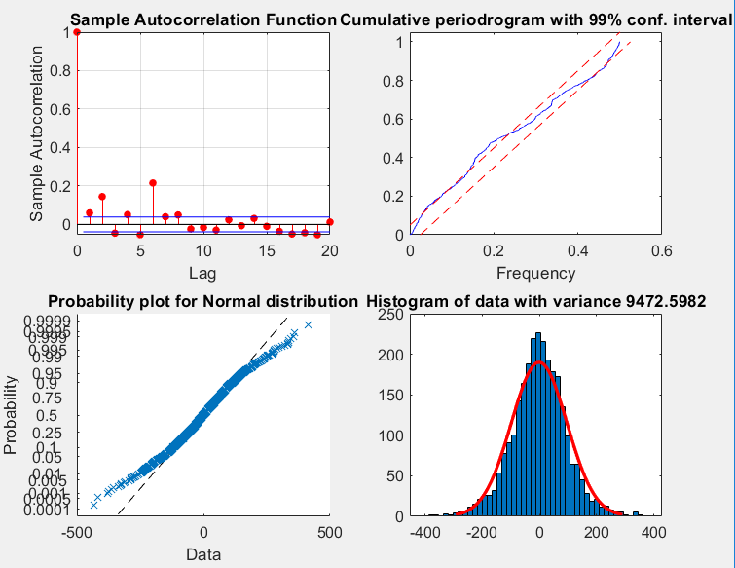
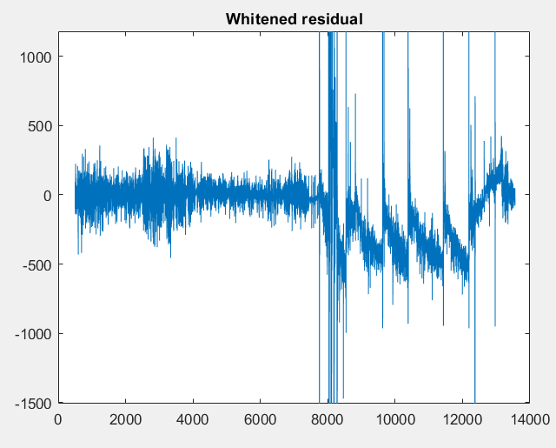
Residual Whitening, results
Non-normality became stronger
Whiteness enforced

Slide 19
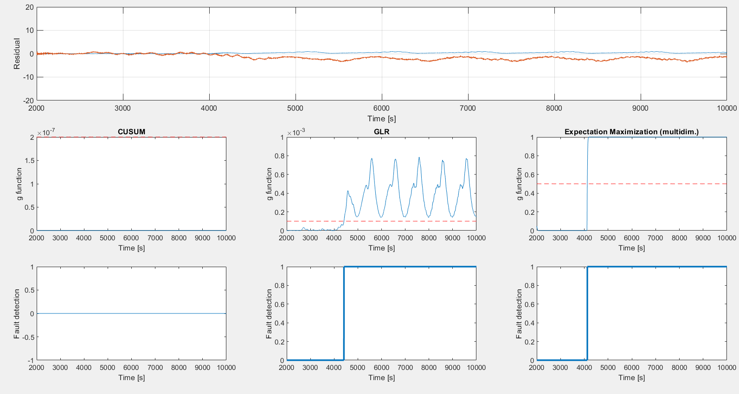
Fault Detection, simulation

Slide 20
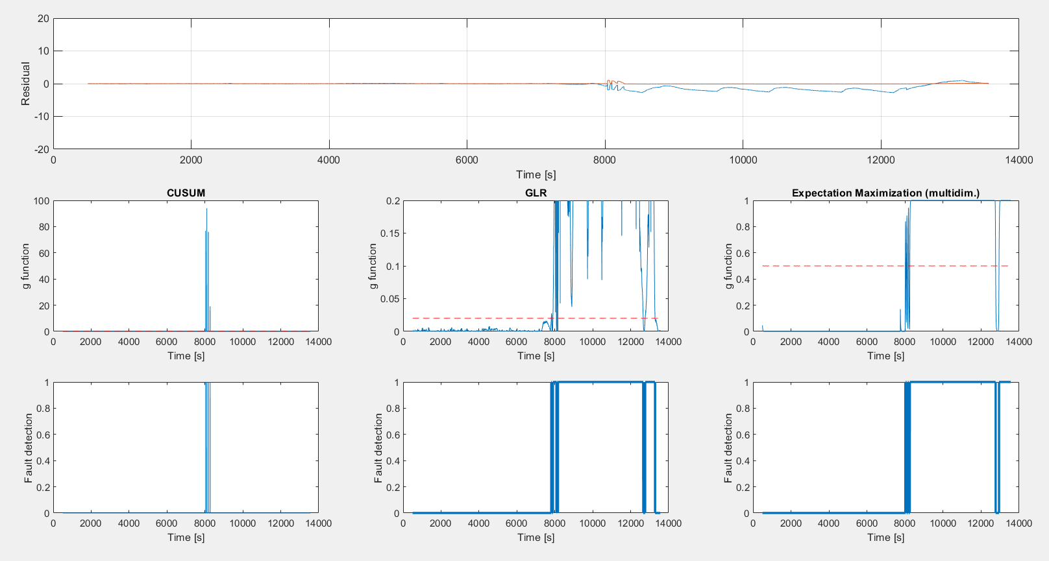
Fault Detection, field data

Slide 21
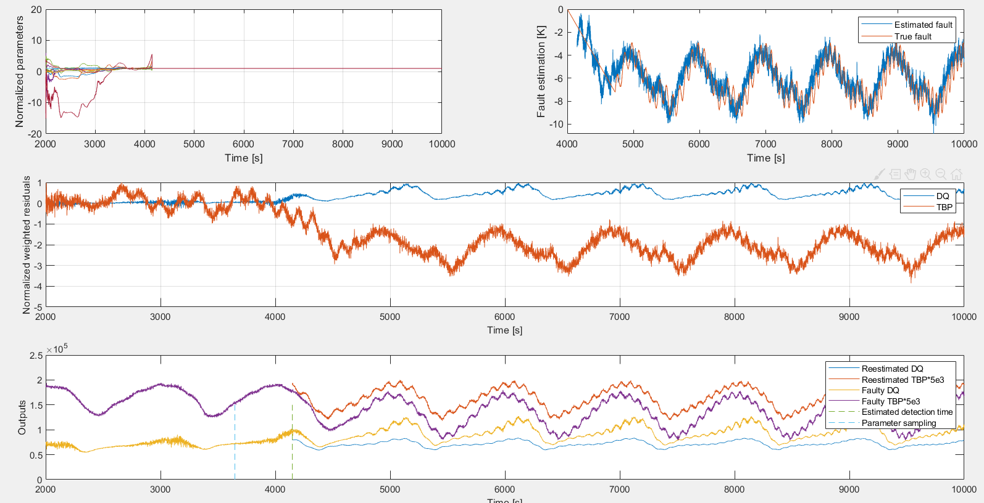
Fault Operation, simulation

Slide 22
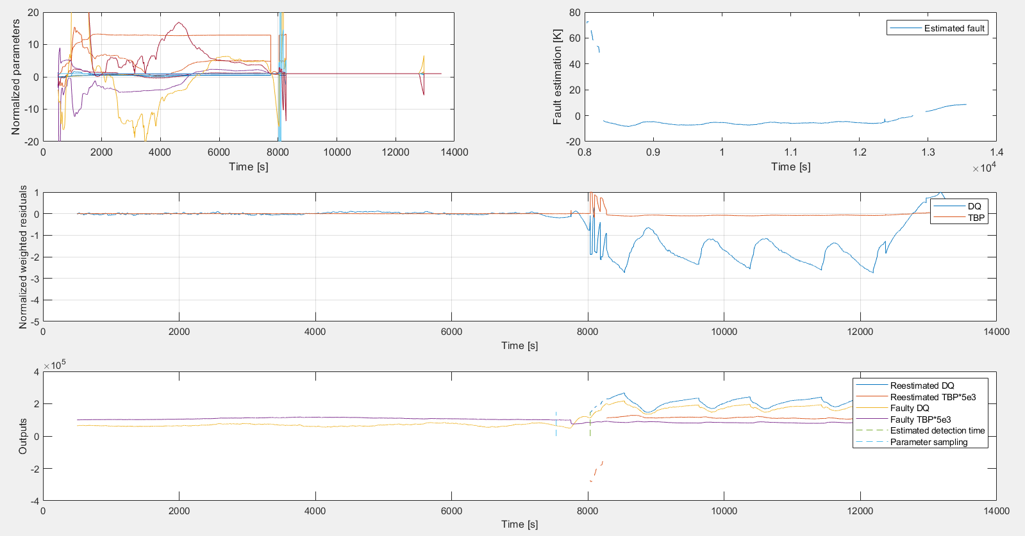
Fault Operation, field data

Slide 23
Conclusion
Residual is created, fault detection is done
CUSUM needs further investigation
Further topics of the thesis
Linear analysis of a set-point (system dynamics check)
LTV Kalman filter (with or without constraints)
Fault detection based control (distributed PI controller) comparison
Do the results improve?

Slide 24
Thank you for the attention!

